Slide 1

premier league ranking Prediction
Group 07
Fanqi Zheng, Yihang Li

Slide 2
Goal of the project
As for our final project, we would like to analyze the data of teams in Premier League.
We analyze their performance based on the first 19 rounds in one season and then predict the results of the rest of matches.
Finally, we would give a prediction of final ranking(top 5) and the best player in specific season based on data above.

Slide 3
Use Case
Input: | Season between 2008 - 2015
Output: | Predict results of matches in last 19 rounds in this season Accuracy rate of the predict results A prediction of the final ranking (top 5 teams) in this season The real top 5 teams in this season

Slide 4
Methodology
Read training data from SQLite database
Use Scala to clean and filter the data by teams
Use RDD to save training data
Use DecisionTree and NaiveBayes to build a predict model and present the Premier League Standing

Slide 5
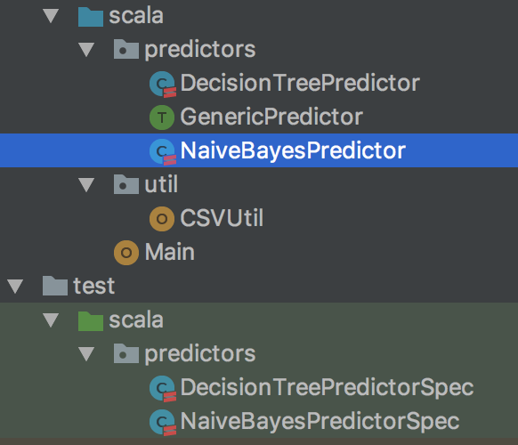
Programming
GenericPredictor.scala
DecisionTreePredictor.scala
NaiveBayesPredictor.scala
CSVUtil
Main
DecisionTreePredictorSpec
NaiveBayesPredictorSpec

Slide 6
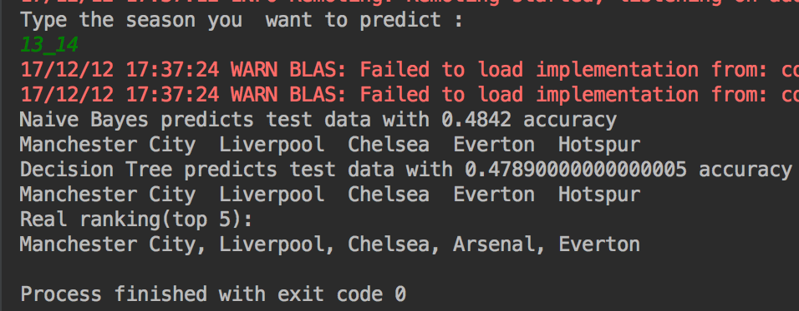
Example
(2013 – 2014 season)
Accuracy rate : | 48.42%(Using decision tree) 47.89%(Using Naïve Bayes)
Top 5 in prediction: | Manchester City, Liverpool, Chelsea, Everton, Hotspur(Using decision tree) Manchester City, Liverpool, Chelsea, Everton, Hotspur(Using Naïve Bayes)
Top 5 in real: | MU, Man City, Chelsea, Arsenal, Hotspur

Slide 7
Result Conclusion
 | 2008 - 2009 | 2009 - 2010 | 2010 - 2011 | 2011 - 2012 | 2012- 2013 | 2013 - 2014 | 2014 - 2015 | 2015 - 2016
Naïve Bayes | 0.4179 | 0.5315 | 0.4068 | 0.5263 | 0.4263 | 0.4842 | 0.4263 | 0.4947
Decision Tree | 0.4526 | 0.4526 | 0.4315 | 0.4894 | 0.4842 | 0.4789 | 0.4578 | 0.3684

Slide 8
Result Conclusion
 | Naïve Bayes | Decision Tree | Real Ranking
2008 - 2009 | MU, Aston Villa, Liverpool, Fulham, Arsenal | MU, Aston Villa, Liverpool, Fulham, Arsenal | MU, Liverpool, Chelsea, Arsenal, Everton
2009 - 2010 | MU, Arsenal, Aston Villa, Chelsea, Hotspur | MU, Arsenal, Aston Villa, Chelsea, Hotspur | Chelsea, MU, Arsenal, Hotspur, Manchester City
2010 - 2011 | MU, Newcastle, Stoke City, Arsenal, Aston Villa | MU, Newcastle, Stoke City, Arsenal, Aston Villa | MU, Chelsea, Manchester City, Arsenal, Hotspur
2011 - 2012 | MU,Man City, Hotspur, Arsenal, Liverpool | MU,Man City, Hotspur, Arsenal, Liverpool | Manchester City, MU, Arsenal, Hotspur, Newcastle United
2012- 2013 | Chelsea, Man City, Everton, Hotspur, Liverpool | Chelsea, Man City, Everton, Hotspur, Liverpool | MU, Manchester City, Chelsea, Arsenal, Hotspur
2013 - 2014 | Man City, Liverpool, Chelsea, Everton, Hotspur | Man City, Liverpool, Chelsea, Everton, Hotspur | Manchester City, Liverpool, Chelsea, Arsenal, Everton
2014 - 2015 | Chelsea, Man City, Southampton, Hotspur, West Ham U | Chelsea, Man City, Southampton, Hotspur, West Ham U | Chelsea, Manchester City, Arsenal, MU, Hotspur
2015 - 2016 | Leicester City, Hotspur, Man City, Chelsea, Southampton | Leicester City, Hotspur, Man City, Chelsea, Southampton | Leicester City, Arsenal, Hotspur, Manchester City, MU

Slide 9
Data Source
Records 25,000 matches +10,000 players data history from Seasons 2008 to 2016
Kaggle (https://www.kaggle.com/hugomathien/soccer, https://www.kaggle.com/limmen/premierleague-league-tables-188889-201617)
Code Repository
https://github.com/FanqiZheng/scalafinal

Slide 10
Thank you!

